Slide 1
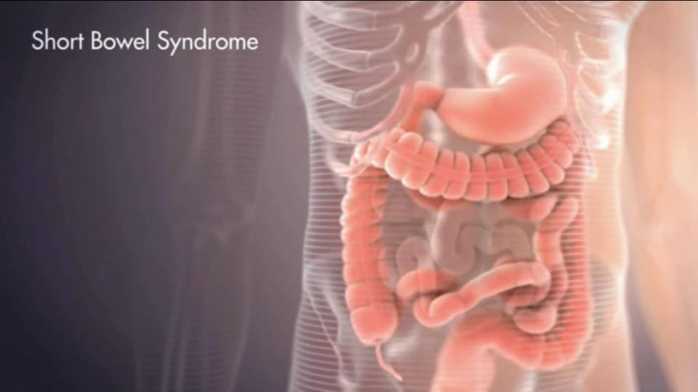
Short Bowel Syndrome
A Rare Disorder: Dissected

Slide 2
Andrew Jablonski Founder and CEO of The Short Bowel Syndrome Foundation, Inc.
29 year old lifelong short bowel syndrome patient
Born with 10.2 cm or 4inches of small intestine, and no ICV
Full colon intact
I am a graduate of Southeast Community College with an Associates of Business Administration and from Doane College with a Bachelors of Human Relations with a Counseling Focus. I am currently a graduate counseling student at Doane.
In 2010 I saw a need for more support and education in the Short Bowel population and started my mission to provide services to those patients and providers in that rare population base.
Since December of 2010 I have been single handily running my organization, spreading awareness, education, and support to the GI industry. Working with two pharmaceutical drug development teams for new novel therapies for SBS.

Slide 3
Lets Define Short Bowel Syndrome
A malabsorpative state that may require massive resection of the small intestine
Average length of the small bowel is:
Neonatal 250cm-300cm in length
Adult 750-800cm in length
50% or more of the small bowel resected is considered short bowel syndrome
Infants have more favorable long term prognosis outcomes, over adult prognosis outcomes

Slide 4
Etiology
Can be congenital or acquired
Congenital
Intestinal atresia
Gastroschisis
Omphalocele
Hirschsprung’s disease
Acquired
Necrotizing Enterocolitis (NEC)
Mid-Gut volvulus
Ischemic injury
Crohn’s disease
Radiation enteritis

Slide 5
Manifestation
Reduction of a functioning bowel mass to below minimally necessary to balance supply & demand of essential body needs, which leads to intestinal failure manifested as:
Fluid & Electrolyte Imbalance
Steatorrhea
Weight Loss & Malnutrition
Mineral deficient: Ca, Mg, Iron, Zinc, fat soluble vitamins
Metabolic acidosis
Gastric acid hypersecretion
Cholelithiasis
Liver Disease
Bone Disease
TPN related complications (Line Infections/Sepsis)

Slide 6
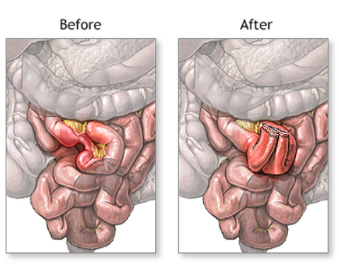
Types of Small Bowel Resections
Duodenal Resection
Jejunal Resection
Ileal Resection
Loss of the ileocecal valve
Colon

Slide 7
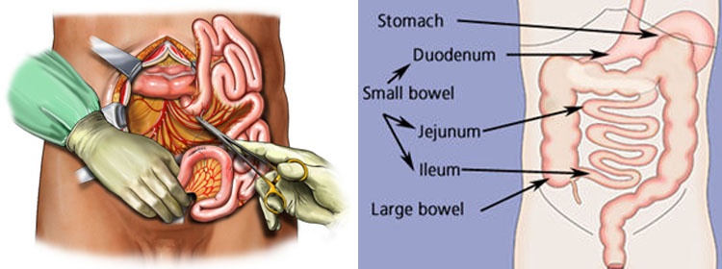
Duodenal Resection
Resection of the Duodenum results in the following deficits:
Protein, Carbohydrates, fat malabsorption
Calcium, Magnesium, Iron, Folate malabsorption
Fat soluble vitamin deficiencies

Slide 8
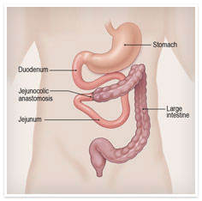
Jejunal Resection
Carbohydrate malabsorption
Water soluble vitamin deficiencies
Ileal adaptation
Malabsorption becomes transient

Slide 9
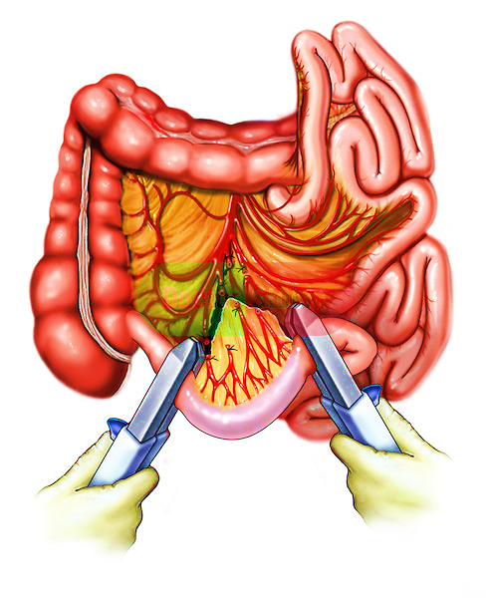
Ileal Resection
Steatorrhea as bile salts not absorbed
Cholesterol stones are a secondary, due to loss of bile acids
Fat soluble vitamin deficiencies
B12 deficiencies
Loss of Ileocecal valve + decrease transit time = chronic diarrhea

Slide 10
Loss of Ileocecal Valve
Loss of the Ileocecal Valve or ICV is the filter between the small and large bowel, located at the end of the ileum. Patients without an ICV are more at risk for:
Bacterial Overgrowth or Small Bowel Bacterial Overgrowth (SIBO)
Allows bacteria to reflux from the colon back into the ileum, which can result in infection, acidosis, or behavioral changes until resolved or medicated.
Rapid transit time that exacerbates malabsorption
No ICV results in rapid transit from the small intestine to large intestine, which leaves no room for adequate absorption in the small bowel. Rapid transit results in chronic diarrhea, which at times is watery or non-formed. For patients with no ICV chronic diarrhea is their normal cycle.

Slide 11
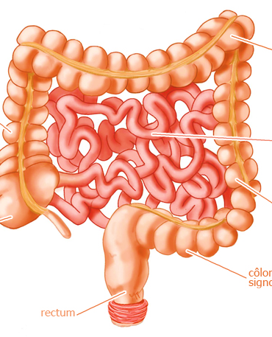
Colon
What is it for:
Water absorption
Gives additional length, slows down transit time; slows gastric empting
Although…
Lactic acidosis can occur:
A conversion of CHO by lactobacillus to D-lactic acid which can lead to metabolic acidosis
This is how SIBO begins

Slide 12
Intestinal Adaptation
Intestinal adaptation starts 24-48 hours post-op
Enteral and parenteral feeds are started as early as possible for nutrition
Adaptation lasts up to 11-12 years
The intestine changes in morphorogy, width, and functional capacity.

Slide 13
Changes in morphorogy
Increase in length
Villus increase in height and diameter
Short Bowel Patients have stunted villus
In 2012 NPS PHARMA a NJ based pharmaceutical created GATTEX® a new novel SBS therapy injection (GLP-2) that increases the intestinal villi of the short bowel patient. Allowing the small bowel to absorb more, and further adapt in functional capacity.
GATTEX® was FDA approved on December 22, 2012
GATTEX® and NPS PHARMA were acquired by Shire Pharmaceuticals in March 2015
In 2016 NAIA Pharmaceuticals in CA, got FDA orphan status for their newly patented drug NB 1001. Which is made of GLP-1. It will be an injection. Drug development is underway. Release date TBA.

Slide 14
Phases of Short Bowel Syndrome
Active Phase
Adaptation Phase
Maintenance Phase

Slide 15
Active Phase
Starts immediately after bowel resection and lasts 1-3 months
Output is greater than 5 liters per day
This includes ostomy output is patient has an ostomy
Life threatening dehydration and electrolyte imbalances
Extremely poor absorption of all nutrients
Reliant solely on parenteral and enteral nutritional feeds for adequate nutrition

Slide 16
Adaptation Phase
Begins 12-24 hours after resection and lasts up to 1-2 years
90% adaptation occurs during this phase
Villus hyperplasia and increased crypt depth occurs resulting in increased absorptive area
Nutrition is essential for adaptation and should be started as soon as possible
Parenteral Nutrition is essential throughout this period

Slide 17
Maintenance phase
Absorptive capacity is at a maximum at this phase
Nutritional metabolic homeostasis can be achieved with oral feeding
Patients start to become more educated about their condition
They will want to start playing a bigger role in their healthcare. Intestinal Rehab is a TEAM effort and not just “doctor’s orders”. In order to achieve best results the patient and physician must be able to listen to each other, and take each others feedback seriously and take into consideration new treatment options or therapies.
Parents of patients become very educated about their child’s illness and will come prepared with ideas, options, and questions about how to best benefit their child with SBS.

Slide 18
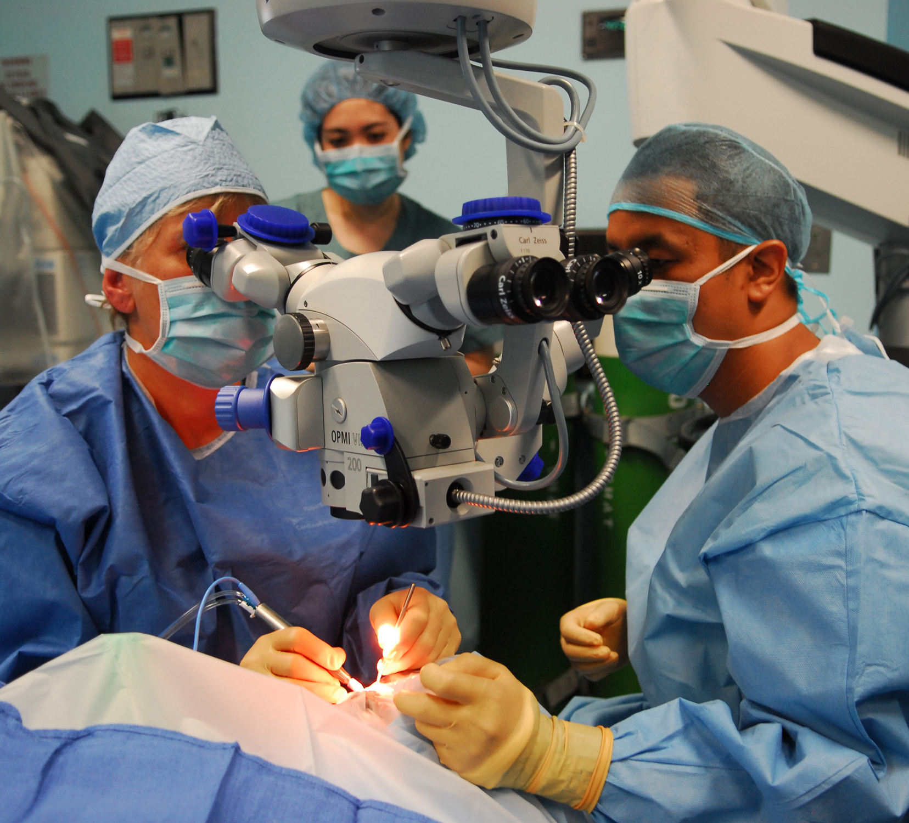
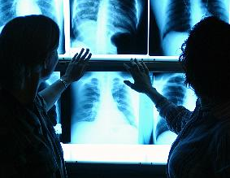
Diagnosing Short Bowel Syndrome
There are multiple different ways to come to a diagnosis of SBS through:
Lab studies
Microbiology
Radiology
Nutrition
Surgical

Slide 19
Labs
Blood Profile
U&E, Bone profile, Mg---PRN then biweekly
CBC, triglycerides, cholesterol---Weekly
Folate, B12, Copper, Zinc---Monthly
Blood gas for suspected lactic acidosis---PRN and Monthly

Slide 20
Microbiology
SEPSIS
If you suspect sepsis blood and urine is ordered for cultures
Cultures are collected from BOTH central and peripheral sites
Consider opportunistic infections, search for fungal infections
Sepsis is a common complication of SBS and also the most fatal
Sepsis cases in Short Bowel result from an infected line or portacath

Slide 21
Imagining Studies
To access for potential complications
Infection
Abdominal ultrasound to look for fungal balls in the kidneys, gallstones, or any other indicators of infection
Bowel Obstruction
Plain radiography
Barium imaging study of the small and large bowel
Liver Disease
Abdominal ultrasound to study the liver, biliary tract, and presence of ascites

Slide 22
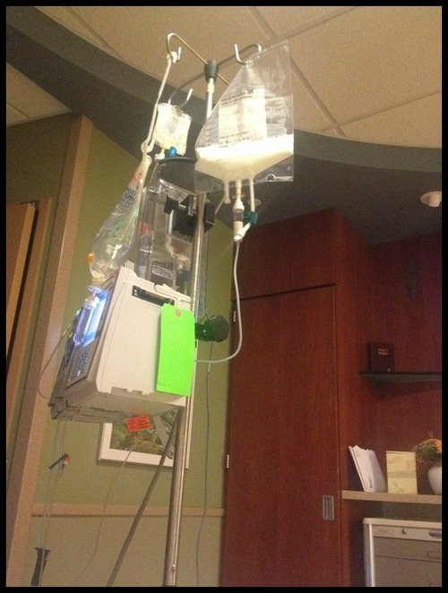
Nutritional Therapy
3 main goals to achieve with nutritional therapy
Maintain adequate nutrition
Promote Intestinal Adaptation
Avoid Complications
Parenteral Nutrition
Most patients are on TPN for 7x a week, 12-18 hours of the day
Multiple line infections and line replacements over the course of years
High risk for Septic Infection
Volume and Rate of PN determined on patient condition
Enteral Nutrition
When hemodynamic stable and fluid management is stable
Continious feeds to prevent osmotic diarrhea
Bolus feeds less well tolerated
Formula osmolality should be <310 mosm/kg
This will differ from patient to patient

Slide 23
Surgical Care
Small Bowel Resections
Line Placement/Replacements
Gastrostomy Tube Placement/Replacements
Non-Transplant Procedures
Serial Transverse Enteroplasty (S.T.E.P.)
Bianchi Procedure
Small Intestinal Transplantation
Isolated Small Bowel Transplant
Multivisceral Transplant (Stomach, Small, Large, Colon, Liver)

Slide 24
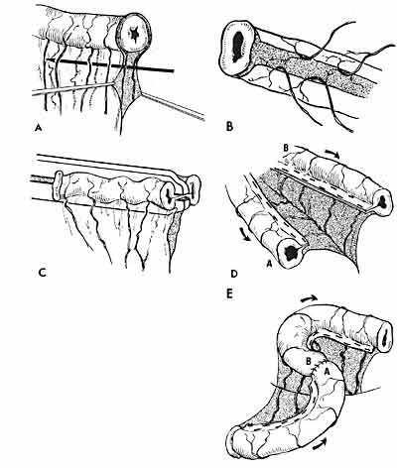
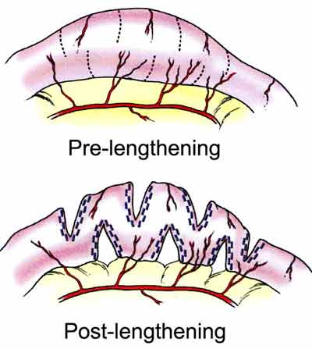
Non-Transplant Procedures
Bianchi Procedure
Known as intestinal tapering or lengthening
Indicated in small bowel with bacterial overgrowth, dilated bowel and continuous malabsorption
Procedure is done by cutting the bowel longitudinally, creating a segment of bowel twice the length, half in diameter without loss of the mucosal surface area
Serial Transverse Enteroplasty (S.T.E.P)
In the STEP procedure, the procedure is done by:
Surgeon makes cuts in the intestine and creating a zigzag pattern
Surgeons lengthen the amount of bowel available to absorb nutrients.

Slide 25
Small Bowel Transplantation
Indicators
Impending or overt liver failure
IV access loss
Frequent related central line sepsis
Intestinal Failure or Failure to Thrive
Pediatric patients have a larger survival window than adults (3-20 years)
Adult patients have a post-op survival rate of 5-15 years
Some patients have died 1 year post op
Some adult patients have surpassed the 15 year window
Patients have mixed results and success with the procedure. Rejection is the biggest factor to consider. Intestines are not the easiest organ to procure. It does not regrow like the liver.
The Intestine must be a blood match and the deceased patient needs to have similar anatomical and physiological features of the recipient (age, height, weight, support group, social status, psychological evaluations)

Slide 26
Complications
Early Complications
Central Line related complication
Dehydration
Electrolyte imbalance
Chronic Complications
Liver & Biliary Disease
Bacterial Overgrowth
D-Lactic Acidosis
Nutritional Deficiencies
Psychological Issues
Metabolic Complications
Micronutrient deficinines
B12 beficiencies
Bacterial Overgrowth
High Oxalate levels
TPN Related Problems
Liver dysfunction
Catheter related problems
Sepsis events
Look for high fever, rigors, acidosis, lethargic….and trust and listen to your patient….chances are they might know something you don’t! We can all learn something new from time to time.

Slide 27
How Short Bowel Affects Behavior
Malnourishment plays a big role in cognition and personality development and why we act the way we do.

Slide 28
Common DSM-5 Diagnosis's Given
Intellectual Disabilities
ADHD
Autism
Learning Disorders
Speech, Motor, Sensory issues
Depressive Disorders
Major Depressive Disorder
Anxiety Disorders
Separation Anxiety Disorder
Agoraphobia
Panic Disorders/Phobias
Generalized Anxiety Disorder
Post Traumatic Stress Disorder
Anger and Irritability is common in both Pediatric and Adult patients alike, due to imbalanced brain chemistry from malnutrition.
Sleep-Wake Disorders
Insomnia
Waking more than 5x a night
Elimination Disorders (in pediatric patients)
Personality Disorders (in adults)
Substance Abuse (young adults and adults)
Cannabis
Alcohol
Prescription Drugs
Many patients seek out psychotherapy or counseling. Some seek out psychiatric help or are medicated. Some of these disorders with age will disappear overtime.

Slide 29
Resources for Short Bowel Syndrome
Short Bowel Syndrome Foundation, Inc
Andrew Jablonski or www.shortbowelfoundation.org
Nationally recognized as a leading expert in Short Bowel Syndrome
Oley Foundation
Joan Bishop or www.oleyfoundation.org
Focuses on Parenteral and Enteral Nutrition Support
National Organization for Rare Disorders
Kristyn Angel or www.NORD.org
Support for all Rare Disorders
Nebraska Medicine Intestinal Rehabilitation and Transplant Program (Among the Top 10 GI programs in the US)
Dr. David Mercer, MD
Cleveland Clinic Digestive Disease Institute (Top 5 GI programs in the US)
Dr. Donald Kirby, MD
Dr. Kareem Abu-Elmagd, MD, PhD.
Shire Pharmaceuticals (GATTEX®)
www.shortbowelsupport.com
www.Gattex.com
NAIA Pharmaceuticals
www.naia.com

